Slide 1
White box testing techniques

Slide 2
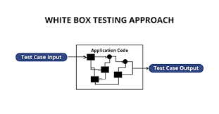
What is white box testing ?
White box testing is a testing technique which evaluates the code and the internal structure of a program.
Notes:
White box testing involves looking at the structure of the code. When you know the internal structure of a product, tests can be conducted to ensure that the internal operations performed according to the specification. And all internal components have been adequately exercised.

Slide 3
Coverage
Code coverage
Segment coverage
Branch Coverage or Node Testing
Compound Condition Coverage
Basis Path Testing
Data Flow Testing (DFT)
Path Testing
Loop Testing
Notes:
Segment coverage: Ensure that each code statement is executed once.
Branch coverage or Node Testing: Coverage of each code branch in from all possible was.
Compound Condition Coverage: For multiple conditions test each condition with multiple paths and combination of the different path to reach that condition.
Basis Path Testing: Each independent path in the code is taken for testing.
Data Flow Testing (DFT): In this approach you track the specific variables through each possible calculation, thus defining the set of intermediate paths through the code.DFT tends to reflect dependencies but it is mainly through sequences of data manipulation. In short, each data variable is tracked and its use is verified. This approach tends to uncover bugs like variables used but not initialize, or declared but not used, and so on.
Path Testing: Path testing is where all possible paths through the code are defined and covered. It's a time-consuming task.
. Loop Testing: These strategies relate to testing single loops, concatenated loops, and nested loops. Independent and dependent code loops and values are tested by this approach.

Slide 4
Why we perform WBT?
To ensure:
That all independent paths within a module have been exercised at least once.
All logical decisions verified on their true and false values.
All loops executed at their boundaries and within their operational bounds internal data structures validity.

Slide 5
To discover the following types of bugs:
Logical error tend to creep into our work when we design and implement functions, conditions or controls that are out of the program
The design errors due to difference between logical flow of the program and the actual implementation
Typographical errors and syntax checking

Slide 6
Does this testing requires detailed programming skills?
We need to write test cases that ensure the complete coverage of the program logic.
For this we need to know the program well i.e. We should know the specification and the code to be tested. Knowledge of programming languages and logic is required for this type of testing.

Slide 7
Limitations
Not possible for testing each and every path of the loops in the program. This means exhaustive testing is impossible for large systems.
This does not mean that WBT is not effective. By selecting important logical paths and data structure for testing is practically possible and effective.

Slide 8
Steps to Perform WBT
Step #1 – Understand the functionality of an application through its source code. Which means that a tester must be well versed with the programming language and the other tools as well techniques used to develop the software.
Step #2– Create the tests and execute them.

Slide 9
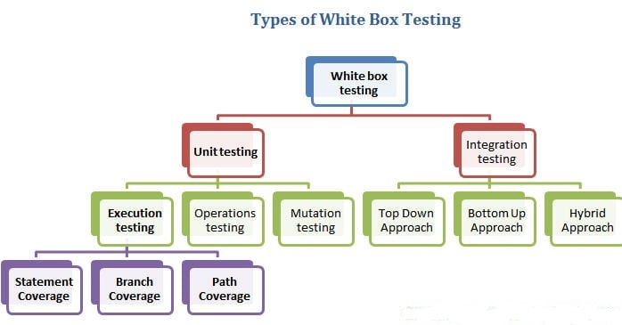
Types and Techniques of White Box Testing

Slide 10
3 Main White Box Testing Techniques:
Statement Coverage
Branch Coverage
Path Coverage
Notes:
Note that the statement, branch or path coverage does not identify any bug or defect that needs to be fixed. It only identifies those lines of code which are either never executed or remains untouched. Based on this further testing can be focused on.

Slide 11
#1) Statement coverage
In a programming language, a statement is nothing but the line of code or instruction for the computer to understand and act accordingly. A statement becomes an executable statement when it gets compiled and converted into the object code and performs the action when the program is in a running mode.
Hence “Statement Coverage”, as the name itself suggests, it is the method of validating whether each and every line of the code is executed at least once.

Slide 12
#2) Branch Coverage
In case of an “IF statement”, there will be two test conditions:
One to validate the true branch and,
Other to validate the false branch.
Notes:
“Branch” in a programming language is like the “IF statements”. An IF statement has two branches: True and False.
So in Branch coverage (also called Decision coverage), we validate whether each branch is executed at least once.
Hence, in theory, Branch Coverage is a testing method which is when executed ensures that each and every branch from each decision point is executed.

Slide 13
#3) Path Coverage
Path coverage tests all the paths of the program. This is a comprehensive technique which ensures that all the paths of the program are traversed at least once.
Path Coverage is even more powerful than Branch coverage. This technique is useful for testing the complex programs.

Slide 14
White Box Testing Example
INPUT A & B
C = A + B
IF C>100
PRINT “ITS DONE”
For Statement Coverage – we would only need one test case to check all the lines of the code.
Notes:
that means:
If I consider TestCase_01 to be (A=40 and B=70), then all the lines of code will be executed.
Now the question arises:
Is that sufficient?
What if I consider my Test case as A=33 and B=45?
Because Statement coverage will only cover the true side, for the pseudo code, only one test case would NOT be sufficient to test it. As a tester, we have to consider the negative cases as well.
Hence for maximum coverage, we need to consider “Branch Coverage”, which will evaluate the “FALSE” conditions.

Slide 15
INPUT
A & B
C = A + B
IF C>100 PRINT “ITS DONE”
ELSE
PRINT “ITS PENDING”
Notes:
So for Branch coverage, we would require two test cases to complete the testing of this pseudo code.
TestCase_01: A=33, B=45
TestCase_02: A=25, B=30
With this, we can see that each and every line of the code is executed at least once

